Slide 1
Spring MVC
Authored by : Sangeeta Joshi Presented by: Sangeeta Joshi

Slide 2
Agenda
  - MVC Architecture
  Components in Spring MVC module
  Spring MVC

Slide 3
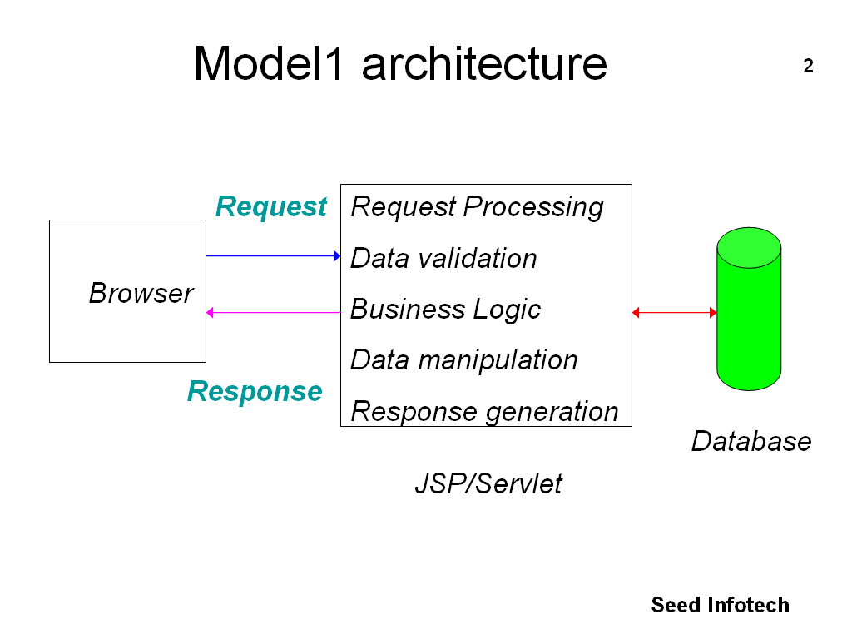
Spring

Slide 4
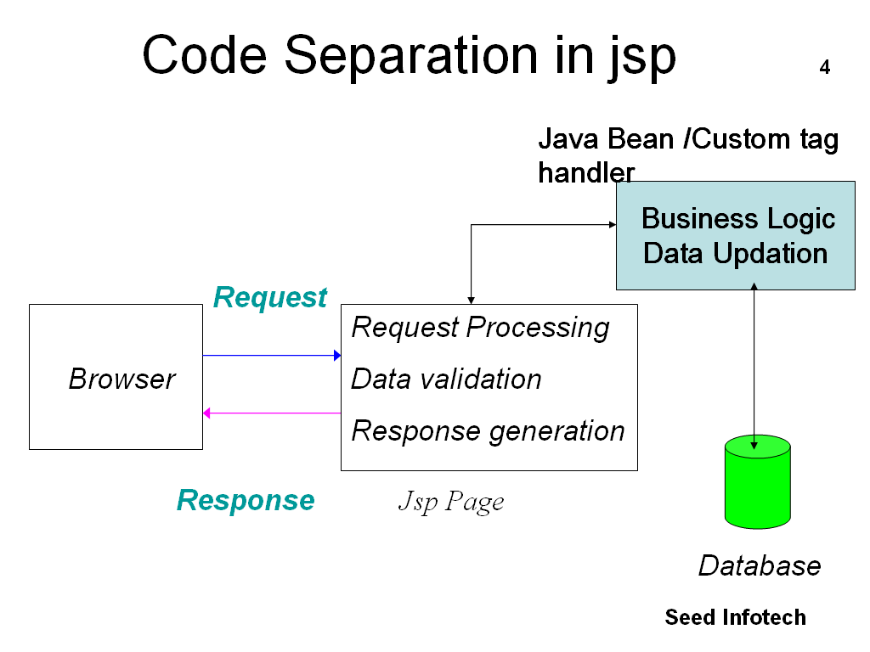
Enhanced Model- I

Slide 5
Spring MVC features
Spring’s own MVC structure providing modularity
Spring’s own custom tag library used in JSP
Configuration not tied to specific presentation technology
Supports client side data format validations.
IOC and AOP support can be wired in MVC configurations.
Supports Internationalization

Slide 6
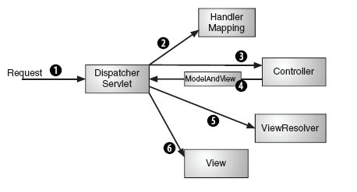
Spring MVC Architecture

Slide 7
Components
DispatcherServlet
  A single FrontController Servlet
Controller
  It processes the request, invoking the business layer
HandlerMapper
  DispatcherServlet takes help of HandlerMapper to find out exact Controller for that request
ModelAndView
  A controller bundles model data and name of a view inside the ModelAndView and sends back to Servlet

Slide 8
Components
ViewResolver
  DispatcherServlet asks a ViewResolver to find the view such as actual JSP
View
  It will use the model data to render a page that will be sent back to browser

Slide 9
Controller
DispatcherServlet and Controllers are handling the responsibility of “Controller” in Spring MVC
DispatcherServlet takes the input request and forwards it to an appropriate Controller
It is provided by the Spring Framework to developers
Controllers are responsible for delegating the task to actual Business components
  A controller is an interface to the application’s functionality provided by Spring framework

Slide 10
Model
The Model is based on the Map interface that allows for the abstraction of the view technology
The ModelAndView object encapsulates the relationship between view and model and is returned by corresponding Controller method
The ModelAndView class uses a ModelMap class that is a custom Map implementation where data is stored in key-value format

Slide 11
View
The View page can be explicitly returned as a part of ModelAndView object by the Controller
The View name can be independent of view technology (i.e without using .jsp in a controller ) and resolved to specific technology by using ViewResolver and rendered by the View
Spring enables to use JSPs, XSLT, PDFs, Excels, Tiles as the different view types

Slide 12
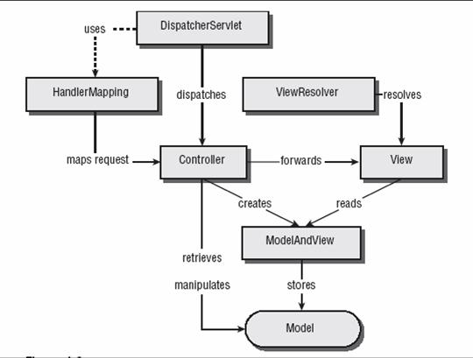
Spring Architecture

Slide 13
Configuring the DispatcherServlet
Configure the DispatcherServlet in web.xml
<servlet> <servlet-name>empServlet</servlet-name>
<servlet-class>org.springframework.web.servlet.DispatcherServlet
</servlet-class>
</servlet>
  DispatcherServlet will try to load the application context from a file named empServlet-servlet.xml
Add the servlet mapping entry for above in web.xml
<servlet-mapping>
<servlet-name>empServlet</servlet-name>
<url-pattern>*.htm</url-pattern>
</servlet-mapping>

Slide 14
Configuring the Controller
Configure the bean for Controller in Spring’s configuration file
<bean name="/emp.htm“ class="com.emp.EmpListController">
<property name=“empService" ref=“empService" />
</bean>
  Any service implementation can be injected in Controller bean
Write a Java Bean extending from AbstractController and override the handleRequestInternal method returning the ModelAndView
return new ModelAndView(“list”, “empl” , empList );
list = logical name of a view
empl = name of the Model object
empList = Actual Model object

Slide 15
Declaring the View Resolver
Configure the View Resolver to resolve logical view name such as “list” returned in ModelAndView to an actual JSP file
<bean id="viewResolver“ class="org.springframework.web.servlet.view.
InternalResourceViewResolver">
<property name="prefix"> <value>/WEB-INF/</value>
</property>
<property name="suffix"><value>.jsp</value></property>
</bean>
If ModelAndView returns logical view name as list, then
InternalResourceViewResolver will try to find the view at
/WEB-INF/list.jsp

Slide 16
Mapping Requests to Controllers
Handler mappings help DispatcherServlet figure out which controller the request should be sent to
It typically maps a specific controller bean to a URL pattern
If No handler mapping is found in the context DispatcherServlet creates a default BeanNameUrlHandlerMapping
Spring MVC’s handler mappings implement the org.springframework.web.servlet.HandlerMapping interface

Slide 17
Types Of Controllers
Core Controllers
  The base interface Controller gives the basic functionality . AbstractController class implements this interface
Command Controllers
  Accept one or more parameters from the request and binds them to the object
  Capable of performing parameter validations.
Form Controllers
  Used in cases where entry form is to be displayed to the User and processing of the entered data needs to be done

Slide 18
Types Of Controllers
View Controllers
  Used when controller needs to display a static view where no processing or retrieval of data is needed
Multiaction Controller
  Used where application has several actions that perform similar logic

Slide 19
Command Controllers in Spring
Command controllers automatically bind HTTP request parameters to a command object
  A command Object is like an ActionForm in Struts but it is a POJO without extending from any Spring specific class
  A controller should extend from AbstractCommandController, overriding the handle method and setting the name of Command class in the controller’s constructor

Slide 20
Command Controllers in Spring
  Spring attempts to match request parameters to properties in Command object and if name matches parameter values are automatically bound to the properties.
  Then Spring calls handle method of the Controller

Slide 21
Form Controllers
Form Controllers extend from Command Controllers and add functionality to display a Form when GET request is received and process the Form when POST is received
A controller should extend from SimpleFormController, overriding the onSubmit method.
If dependent objects need to be added to Command object then override formBackingObject method
SimpleFormController keeps view details in config file, out of java code wiring the following properties inside Controller
  formView
    The logical name of a view to display when the controller receives an HTTP GET request or when any errors are encountered
  successView
    The logical name of a view to display when the form has been submitted successfully
  Validator
    class responsible for validating the input

Slide 22
Validations using Validator interface
Write custom class extending from Validator interface implementing validate and supports methods
  supports
    It is used by Spring to determine whether validator can be used for the given class
  validate
    It examines fields of object passed to it and rejects any invalid values via Errors object
Configure the controller wiring validator property in it along with the formView and successView
<bean id=“empController“ class="com.emp.EmployeeController">
<property name="formView" value="addRant" />
<property name="successView" value="rantAdded" />
<property name="validator">
<bean class="com.emp.EmployeeValidator" />
</property>
</bean>

Slide 23
Validating with Commons Validator
Configure the DefaultBeanValidator, which is the Spring module’s implementation of Validator. Wire the validatorFactory property
<bean id="beanValidator" class= "org.springmodules.commons.validator.DefaultBeanValidator">
<property name="validatorFactory" ref="validatorFactory" />
</bean>
Configure validatorFactory
<bean id="validatorFactory" class=
"org.springmodules.commons.validator.DefaultValidatorFactory">
<property name="validationConfigLocations">
<list><value>WEB-INF/validator-rules.xml</value>
<value>WEB-INF/validation.xml</value>
</list>
</property>
</bean>

Slide 24
View Resolvers in Spring
In Spring, a View is a bean that renders results to the user
A logical view name given to ModelAndView object is resolved to a View bean by the ViewResolvers
A View Resolver is any bean that implements org.springframework.web.servlet.ViewResolver
View
Dispatcher
Servlet
Controller
ModelAndView
View Name
View
ViewResolver

Slide 25
Types of View Resolvers
View Resolver | How it Works
InternalResource ViewResolver | Resolves logical view names into View objects that are rendered using template file resources such as JSPs, Velocity templates.
BeanName ViewResolver | Finds View interface implementation as a bean in Spring Context, assuming that bean name is logical view name.
ResourceBundle ViewResolver | Uses property file that maps logical view name to the View interface implementation.
XmlViewResolver | Resolves View beans from an XML file that is defined separately from the application context definition files.

Slide 26
Multiple View Resolvers in single Context
<bean id="viewResolver" class=
"org.springframework.web.servlet.view. InternalResourceViewResolver">
<property name="prefix"><value>/WEB-INF/jsp/</value></property>
<property name="suffix"><value>.jsp</value></property>
</bean>
<bean id="beanNameViewResolver" class=
"org.springframework.web.servlet.view.BeanNameViewResolver">
<property name="order"><value>1</value></property>
</bean>
<bean id="xmlFileViewResolver" class=
"org.springframework.web.servlet.view.XmlFileViewResolver">
<property name="location">
<value>/WEB-INF/views.xml</value>
</property>
<property name="order"><value>2</value></property>
</bean>

Slide 27
Any Questions?

